Slide 1
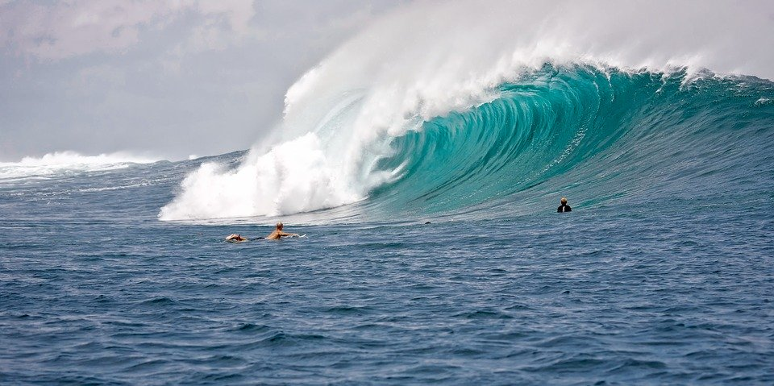

Waves
Experience 2: Wave Properties
With BOCES 4 Science
https://sites.google.com/wflboces.org/boces4science/home
Grade 4 Waves

Slide 2
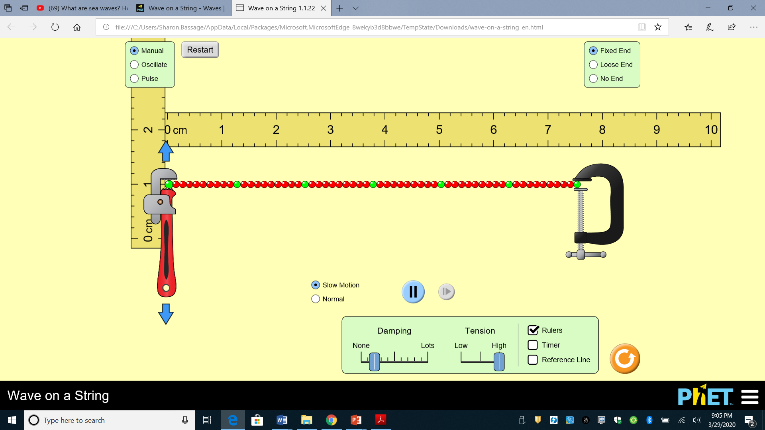
Creating a wave
Vocabulary;
Crest
Trough
Wave
Wavelength
Amplitude
Use the site listed here for “phet colorade”. It is a site that allows students to create waves and manipulate the waves. https://phet.colorado.edu/en/simulation/wave-on-a-string
Alternatively, students can use a jump rope or any rope to create a wave on the floor.

Slide 3

Wave Properties
A wave is a regular pattern of motion either up and down or side to side.
Students should learn about the different properties of waves such as wavelength, crest, trough, and amplitude.
They should be able to draw a wave showing the above properties.
This is a great site with many references to waves and their properties.
https://clarkscience8.weebly.com/properties-of-waves.html

